Slide 1
Year 5 2021
Mrs Nicole Bond
Mrs Joslyn Selyer

Slide 2
Mornings and after school
Upon arriving at school students are asked to sit or stand in front of the library with hat on! Students are not to drop bags off or walk by classroom as there is no supervision!
Class doors open at 8.20. If you arrive to school after 8.35 that is considered late, and your child will need to sign in at the office.
Students are to come in and complete their morning rotations. These start at 8:20 so please be prompt!
After school, students are expected to sit with their youngest sibling in the designated areas. Students walking to Irene McCormack will be walked over by a staff member.

Slide 3
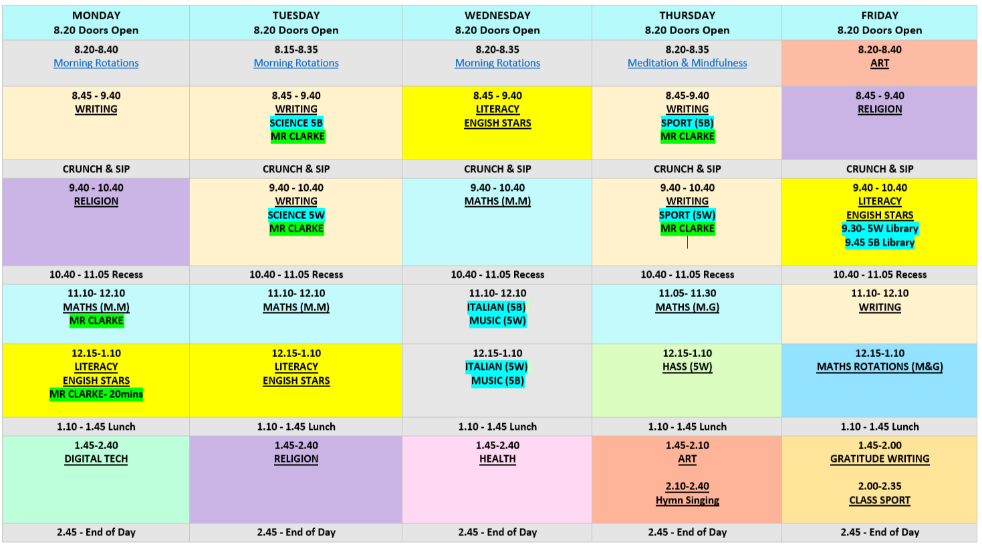
Weekly Timetable
Tuesday
Science
Wednesday
Italian & Music
Thursday
Sport
Friday
Class Sport & Library

Slide 4
iPads
Parent / Student Agreement The use of iPad while at school is a privilege and not a right. I understand that if I am in breach of the Brighton Catholic Primary School Code of Conduct and Agreement Policy, I may lose my iPad and technology resources privilege. It is my responsibility to report and where appropriate, remind my child of the commitment made to the school when signing this iPad Code of Conduct and Agreement. STUDENT I, ______________________________________ have read and discussed this agreement with my parent(s); and accept the terms by which I shall use my iPad at Brighton Catholic Primary School. PARENT/CARER As the parent/carer of _______________________ , I give permission for my child to have access to an iPad while at Brighton Catholic Primary School. I have read and discussed the terms of the agreement with my child; and will support Brighton Catholic Primary School in the implementation of this Acceptable Use and Code of Conduct Agreement. STUDENT​​​​​​ Name: __________________Signature: _____________________ PARENT/ CARER
Name:__________________Signature: _____________________
Name:__________________Signature: _____________________
Attention!
Must be 100% charged every day!
Update policy that now included costs relating to damaged ipads. So please report any damage ASAP to the teacher (screens, chargers…) so we can investigate further.

Slide 5
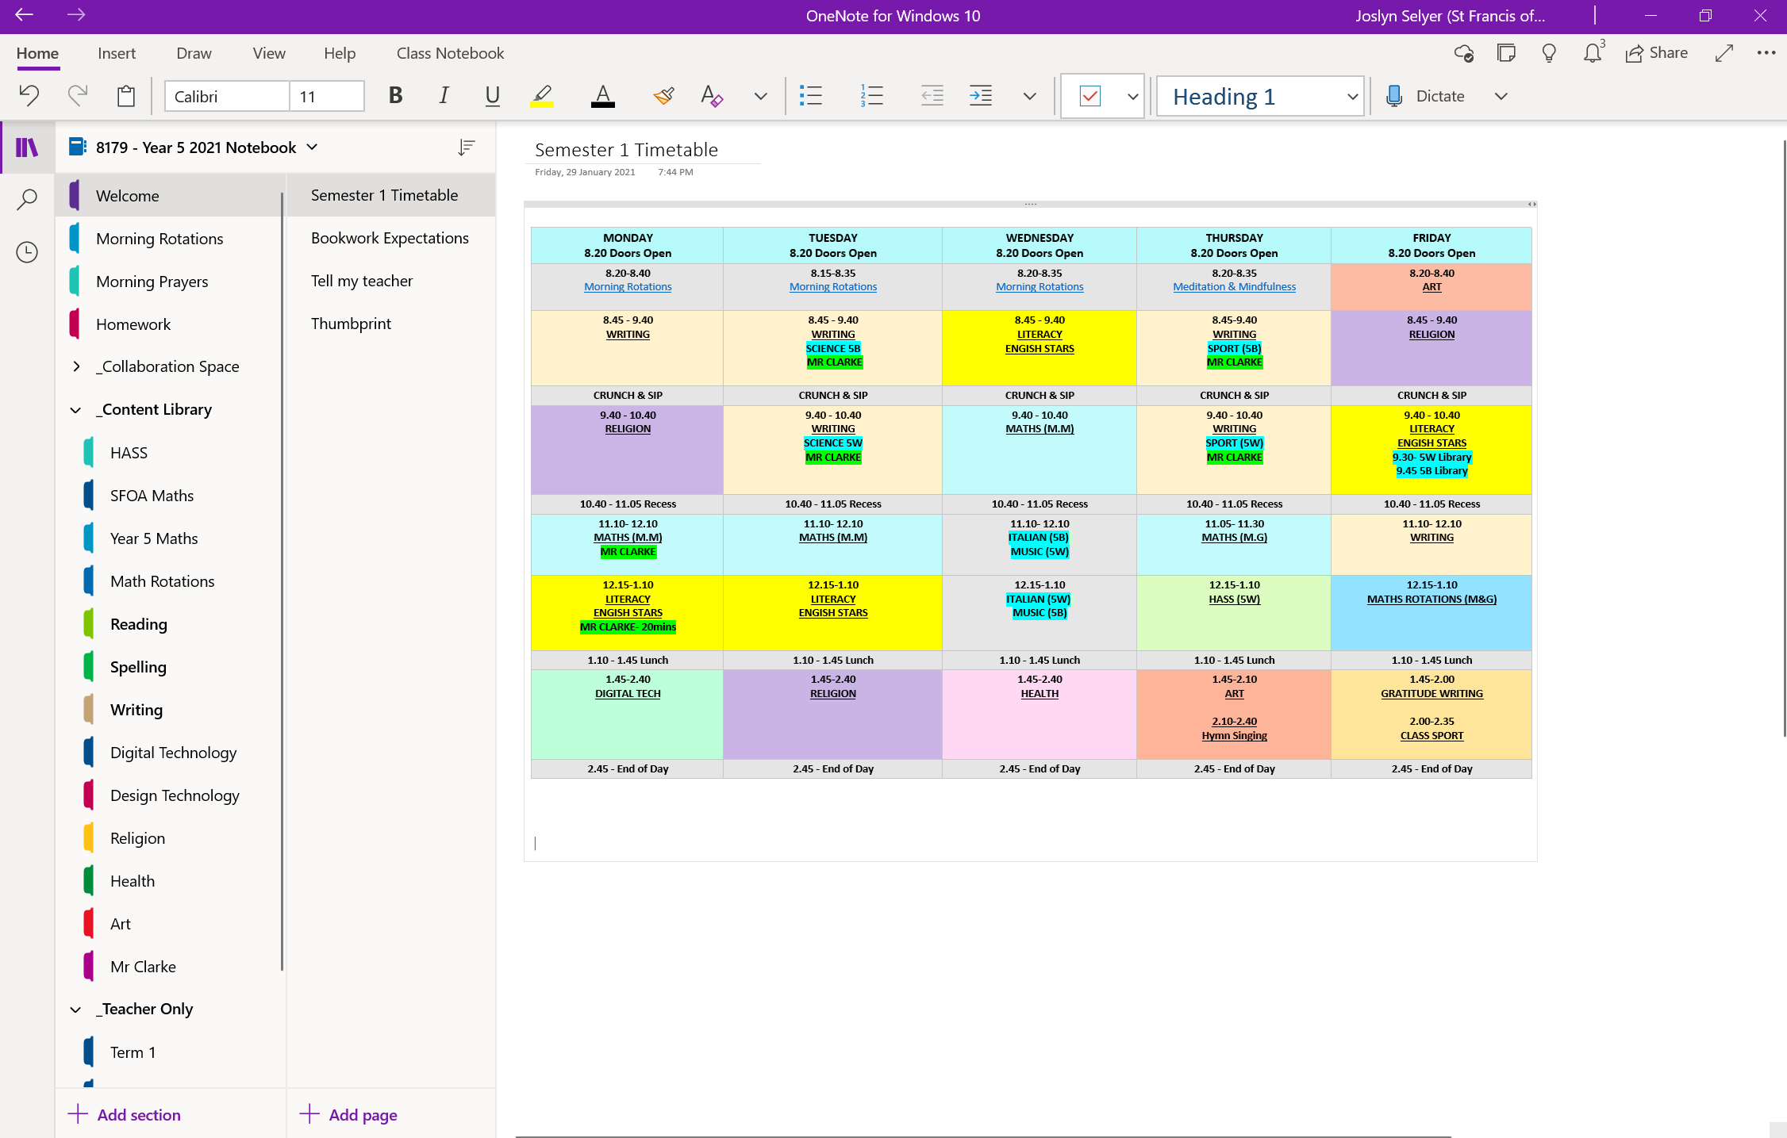
One Note

Slide 6
Literacy
Teaching at ‘point of need’, moving students forward.
Students are grouped to teach at point of need.
English Stars - incorporates spelling, grammar and comprehension activities. It includes written assignments and oral presentations based on the featured text type of the unit, knowledge Tests include the language conventions covered in the Yearly Plan prior to the test, Comprehension Tests are discrete opportunities to assess students’ comprehension skills as the year progresses and Spelling Tests are included at the end of every unit and test students’ knowledge of the spelling concepts taught in that unit.
Guided Reading – small group work. Each student reads with a teacher once a week.
Literacy Pro – home reading program which involves a quiz at the end of the book.
Talk 4 Writing - writing program. This term we will be covering Persuasive and Narrative writing.

Slide 7
Mathematics
Teaching at ‘point of need’, moving students forward.
Students are grouped to teach at point of need.
Post tests to monitor learning and progress.
I do, we do, you do, plough back, explicit teaching model.
Number and Algebra
Mon, Tues, Wed,
On Mondays we will have extra support from Mr Clarke.
Measurement and Geometry
Thurs, Fri with rotations to incorporate all styles of learning

Slide 8
Mathematics
Term Topics
Term 1
N&A- Four orders of operation
M&G- Lines & Angles, Symmetry & Transformations, 3D Objects & Cross Sections
Term 2
N&A- Fractions, decimals
M&G- Perimeter & Area, Weight & Mass, Volume & Capacity, Metric Units
Term 3
N&A- Percentages and money
M&G- 24hr time, Coordinates & Mapping
Term 4
N&A- Pre-Algebra and Number Patterns
M&G- Data & Stats, Chance & Probability

Slide 9
Religious Education
Relationship Restored (Penance)
Choosing to do Good (Lent/Easter)
Nourishing Our Goodness (Eucharist)
We are Called (Baptism)
The Spirit Frees (Confirmation)
The Church Community (Church)
All Creation Gives Thanks (Prayer)
Helped by the Word (Advent)

Slide 10
Keeping Safe

Slide 11
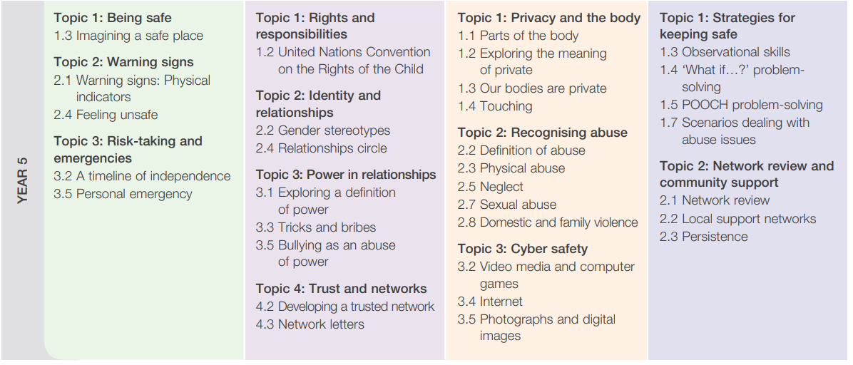
Keeping Safe

Slide 12
Specialists
Year 5 Children will need to know the responsibilities of different roles that are required in games such as umpires, players and coaches. They will need to follow, apply and understand rules in games. Students will usually be able to catch the object while stationary, over short to medium distances; however, is less successful under pressure. They usually select an appropriate throw for the specific situation, often showing accuracy and control to reach the intended target while under some pressure and will have basic understanding offence and defense and when they are needed.

Slide 13
Specialists
Students revisit and are consolidating language developed in previous years and interact to exchange information about their home and their personal and social worlds. They are becoming more confident about using a bilingual dictionary and their ability to formulate questions to find out specific information. They greet peers and teachers and respond to questions appropriately and are recognising when to use the formal form of the third person. They can use simple conjunctions, prepositions and can express preferences and negations in their oral or written communications. They will research an Italian region with a partner and will create and present a PowerPoint of their chosen region.

Slide 14
Specialists
Students will continue to learn recorder and will also be introduced to the ukulele. Pitch and rhythm will continue to be covered and students will learn to sing the whole major scale. Students will learn different chords on the ukulele and how to play simple songs. Students will also do a listening assignment on different music artists throughout time.

Slide 15
Specialists
Children will be learning that living things have structural features and adaptations that help them to survive in their environment. They will examine how particular living things have adapted to a range of environments such as the desert, the bush and the rainforest and how these adaptations help survival.

Slide 16
Uniform
Summer Uniform
Terms 1&4
Girls | Boys
Girls summer school dress. All black leather lace-up shoes. (No velcro, canvas or Mary-Jane shoes permitted). All white school socks (must not have any brand names/symbols or colours visible, and no ankle socks). Black wide-brimmed school hat with school logo. Optional: Red woollen jumper with school logo. | Charcoal school shorts. White short sleeve shirt with school crest. All black leather lace-up shoes. (No velcro, canvas or Mary-Jane shoes permitted). All white school socks (must not have any brand names/symbols or colours visible, and no ankle socks). Black wide-brimmed school hat with school logo. Optional: Red woollen jumper with school logo.
Sun Safety
School hats are to be worn all year round, regardless of the weather conditions.
Hair
Regardless of gender, long hair (hair that sits below the collar) should be neatly tied up or braided, and secured with a hair elastic.
Jewellery
A plain watch may be worn. No 'Smart watches' (eg. Apple watches) are permitted. A simple chain/ necklace with a cross or Catholic medallion is permitted. This must be worn underneath items of clothing. 1 pair of plain gold or silver studs or small sleepers may be worn in the lower ear lobes.
Nail Polish and Makeup
Coloured nail polish and/or makeup is not to be worn to school.

Slide 17
Important Date
Year 5 Class Mass- Friday 26th March
Excursion-
Perth Mint and Heritage Walk- 6th of April, Term 1
Assembly- Friday 7th May
Term 3 excursion tbc.
Incursions
Transperth- Term 3
RAC- Term 4
Sleep Over- Friday 30th of October, Term 4

Slide 18
Homework
Homework will be relevant, and the tasks will be carefully and clearly defined for the students.
Teachers need to be aware of family commitments that may prevent children from completing their homework on occasions. Homework should not be used as a punishment.
In Year Five we follow a weekly ‘Homework Template’. This contains a variety of activities that students can select from. Each week students have a page in their homework books to document their spelling and reading. There is also a space for you to sign off that you have witnessed your child completing these tasks.
Building time management skills for high school, students will learn to prioritise and put time aside for work.

Slide 19
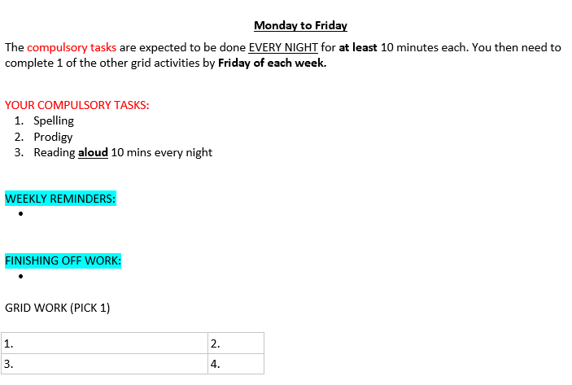
Homework

Slide 20
Behaviour Management
Positive behaviours will be recognised and encouraged.
Positive decisions, good behaviour and work ethic rewarded through positive reinforcements.
The School Behaviour management plan is designed to minimise interruptions from inappropriate behaviour in order to maximise the teaching and learning process. The Behaviour Plan also acts as a pathway, in conjunction with parents, to guide our students to become active, responsible, considerate, giving members of the community.
A warning system applies in our classrooms. 3 warnings, time out and reflection in a partner room. If students continue to make poor choices with regards to their behaviour we will contact you to discuss things further. In extreme cases you will be informed and Leadership may be involved.

Slide 21
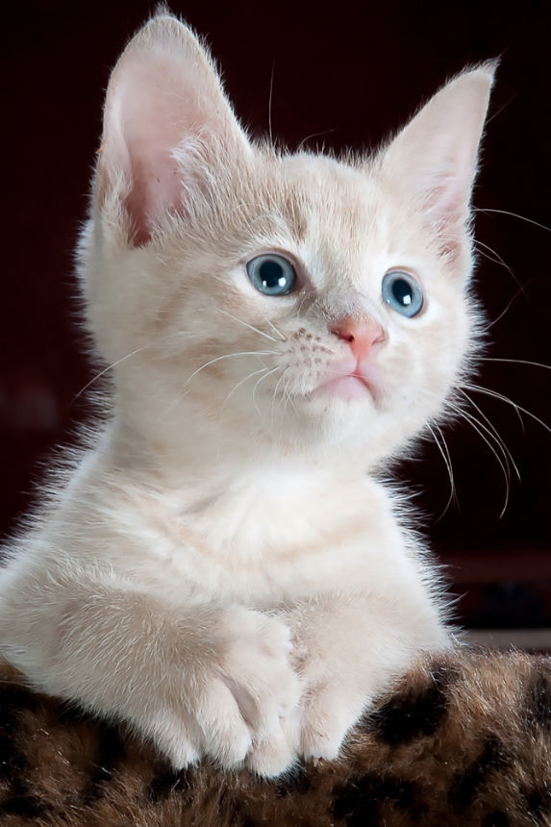
Social Worker
Julie Ford
Julie.Ford@cewa.edu.au
Coffee catch up mornings

Slide 22
Absentees
A written note, email is required to explain absences. Notes must be dated and signed by a legal guardian.

Slide 23
NAPLAN & Bishop’s Literacy Tests
NAPLAN testing will take place in Term 2
All schools are moving to NAPLAN Online. Headphones will be used for any test that has audio and we will access a locked down browser.
Bishop’s Literacy Test is Term 3

Slide 24
Meetings/Teacher Contact
If you would like to arrange a meeting please email us to organise a suitable time to meet.
Please ensure we are your first point of contact before Leadership. If you contact them directly, they will refer you back to us.
Josyln.selyer@cewa.edu.au
Nicole.bond@cewa.edu.au

Slide 25
Seesaw
Information, and student work samples will be frequently uploaded to Seesaw. If you haven’t already, please sign up for your child’s account on Seesaw.
*Please refrain from using Seesaw as a way of communicating with us. It is a platform for notes home and student work. If you wish to contact us, please do so via email or a phone call.

Slide 26
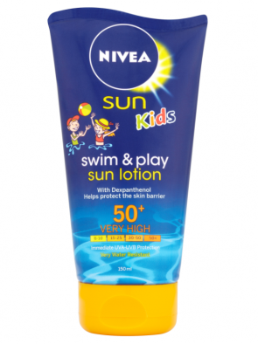
Sun Smart policy
Students will:
Comply with Sun Safe rules and guidelines by school hats, school uniform, sunscreen and sunglasses;
Apply SPF 30+ broad-spectrum, water-resistant sunscreen 20 minutes before going outdoors;
Use shaded or covered areas when outdoors;
Act as positive role models for other students in all aspects of Sun Safe behaviour.

Slide 27
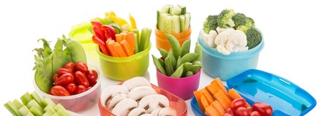
Crunch & Sip
The Crunch&Sip program is an easy way to help kids stay healthy and happy!
Crunch&Sip is a set time during the school day to eat vegetables and fruit and drink water in the classroom. Students bring vegetables or fruit to school each day for the Crunch&Sip break. Each child also has a small clear bottle of water in the classroom to drink throughout the day to prevent dehydration.
Giving students the chance to re-fuel with fruit or vegetables helps to improve physical and mental performance and concentration in the classroom, as well as promoting long term health.
Crunch&Sip is a well-established program in Western Australia, with over 44% of eligible schools across the state currently certified.

Slide 29
Any Questions

